Slide 1
New Methods Require New Skills
Terri Potts, Technical Director
Raytheon Intelligence, Information & Services Software
This document does not contain technology or Technical Data controlled under either the U.S. International Traffic in Arms Regulations or the U.S. Export Administration Regulations.
Notes:
CONTENT OWNERS: ALWAYS REVIEW CONTENT WITH YOUR EX/IM or CONTRACTS REPRESENTATIVE FOR APPROPRIATE MARKINGS
WARNING – Users should ensure they follow the layout instructions found in Raytheon Policy 5024-RG (Global Trade Compliance: Marking and Protection of U.S. Export-Controlled Technical Information) – with the full marking on the first page and a smaller carryover marking on subsequent pages, if required.
TITLE SLIDE PAGES
Security markings can be inserted by clicking into the text block of “Type EX/IM marking, if appropriate, as required by 5024-RG (ex. "ITAR Controlled")”.
INSIDE SLIDE PAGES
Security markings can be inserted by going into the Slide Master Template.
Go to the top menu bar, pull down “View”.
Click the “Slide Master” icon in the horizontal bar.
Click on the top Slide 1.
Type appropriate classification in header and footer.
This will then be applied to all slide pages (except the cover slide).

Slide 2


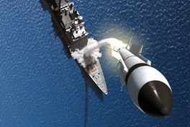





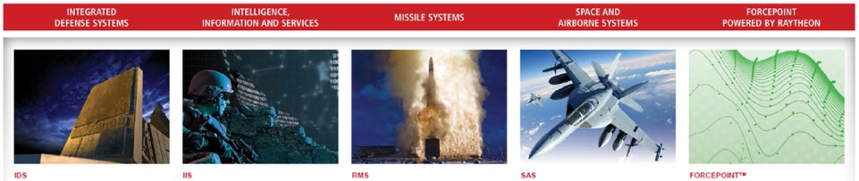
Notes:
Public Raytheon overview in a few sentences – describe some of the systems we work on
From Wikipedia: The Raytheon Company is a major U.S. defense contractor and industrial corporation with core manufacturing concentrations in weapons and military and commercial electronics. It was previously involved in corporate and special-mission aircraft until early 2007. Raytheon is the world's largest producer of guided missiles.^{[5]}
Established in 1922

Slide 3
DevOps in the Commercial World
Development Org +
Operations Org =
DevOps
Notes:
Typical meaning of DevOps
Where development does everything from requirements gathering to qualification testing
Operations organization stands up the environments, and does provisioning and deployment of original software and any patches.
When the system breaks for the User, Ops takes the call (24x7) and resolves the problems.

Slide 4
DevOps in the Commercial World
Development Org
+ Security Org
+ Operations Org =
DevSecOps
Notes:
In some cases, people add Security to include the Security Organization

Slide 5
DevOps at Raytheon
System Eng Org
+ Security Org
+ Hardware + Infrastructure + Software + Integration +
Test + CM+ Operations=
SysSecHWInfSWIntTestCMOps
Notes:
At Raytheon, we have several more organizations involved

Slide 6

Build Bridges Until
Silos Eliminated
Photo courtesy of Stocksnap.io under Creative Commons CC0 license.
Notes:
You don’t change large organizations like Raytheon overnight. Early movements to get us all on a single island, breaking down the barriers betweens organizations started with building bridges between the organizations
Reached across the breach to my counterparts in our systems engineering and infrastructure teams
Jointly built roadmaps
Regularly connect with them to solve cross-organizational problems
Joint presentations
Speak / educate cross-organizational leaders on the benefits of DevOps

Slide 7

Mentoring
Mentoring
Photo under CC0 license, courtesy of https://www.pexels.com/photo/people-office-team-collaboration-7075/
Notes:
Provide recommendations to program DevOps champions:
Book titles
Presentations
Links
Articles
Connect programs beginning adoption with SMEs
Advise proposal teams
DevOps champion & I present in WebEx meetings across the company on DevOps topics

Slide 8

Developer Meetings – small group
Communicate the Vision
Photo courtesy of Shutterstock.com, copyright: Rawpixel.com, Image ID: 378592738
Notes:
Visit all sites
Regularly hold a lunch with developers / technical staff
Walk through the roadmap
Talk specifically about the importance of adopting DevOps, automated test, etc
Goals for organization
Status of where our competitors are
View of where our customers are going, RFPs calling out DevOps
Pass on
Provide recommendations:
Book titles
Presentations
Links
Articles

Slide 9

Study Groups
Study Groups
Photo courtesy of Stocksnap.io under Creative Commons CC0 license.
Notes:
Purchased The Phoenix Project for the SW LT, ran a study group over 6 weeks to go through the book
Leaders then ran study groups with the leads in their organization
Purchased copies of Leading the Transformation and passed it out to program leaders that don’t see the value of adopting DevOps, automated test, etc

Slide 10

Hired DevOps Champion
Photo courtesy of Shutterstock.com, Image ID: 348067622, Copyright: Bimbim
Notes:
Protect him from being consumed on a program
Provide his time/talent for short term engagements
3-6 months performing analysis on 6Sigma project on where to begin the DevOps transformation
Proposal Support
Protect him from any one program monopolizing his time.

Slide 11

Technology Working Group
Technology Working Group
Photo courtesy of Stocksnap.io under Creative Commons CC0 license.
Notes:
Cross-organizational representatives
Web-ex meetings monthly
Encourage cross-site & cross-program collaboration
Present lessons learned, success stories, etc
Created a repository of presentations, metrics, references, links, etc

Slide 12

Corporate Investment
Internal Investment
Photo courtesy of unsplash.com licensed under Creative Commons CC0 license.
Notes:
Internal Symposium
Track dedicated to Agile and DevOps
Research on transition to DevOps
White papers
Developed Deployment Architecture – related to Raytheon lifecycle processes
Aspen Center / Dojo Concept
Sending people to conferences (DevOps Enterprise Summit, PuppetConf, etc)
Internal Research and Development projects
Achievement awards specifically for people leading DevOps adoption

Slide 13

External Involvement
Look outside the org
Photo courtesy of unsplash.com licensed under Creative Commons CC0 license.
Notes:
Participated in DevOps Enterprise Forum
Joint work on papers in 2015 & 2016
Presenting externally and trying to learn from other companies in transition
Building a DevOps network
Joined Denver DevOps Meetup

